Slide 1
PsiQuantum Claims To Develop Quantum Computers With 1 Million Qubits; Raises $215 Million From Microsoft & Welcoming PsiQuantum to the M12 portfolio By Samir Kumar
VISHAL CHAWLA
Vishal Chawla is a senior tech journalist at Analytics India…

Slide 2
Intro
Quantum computing may be the most profoundly world-changing technology uncovered to date – it could bring about revolutionary transformations in climate, energy and healthcare. A quantum computer has the power to unlock commercial value in scenarios where current compute capability faces hurdles.
A new quantum computer under development claims to have 1 million qubits – significantly more powerful than Google’s recent quantum supremacy milestone. Google’s supercomputer currently has 53 qubits.
PsiQuantum, the startup which was founded in 2015 has raised $215 million from M12 and other investors such as from BlackRock Advisors, Founders Fund, Atomico and Redpoint Ventures.
“A useful quantum computer requires at least a million qubits,” says the website of the company. If true, the computer would be incredibly more powerful than machines being developed by Google, IBM, Honeywell, and others.

Slide 3
What’s Different In PsiQuantum’s Approach?
One of the technological hurdles to overcome before we have full-fledged Quantum Computers is the challenge of Error Correction.
PsiQuantum intends to eliminate it with a photonics-based substrate and a quantum computing architecture that takes advantage of photonics.
PsiQuantum has yet to publish academic papers that can be peer-reviewed. The company has not published academic papers that can be evaluated for technology claims. But, the investors stand behind the company and trust its claims.
“While it’s enticing to imagine the benefits and opportunities of a quantum computer, PsiQuantum isn’t distracted by what’s beyond the finish line. They are disciplined and focused on the task at hand: delivering on a machine with hundreds of error-corrected, logical qubits. We at M12 have been impressed by the PsiQuantum team and look forward to their continued development,” wrote Samir Kumar, GM & Managing Director at M12- Microsoft’s Venture Fund in a blog.

Slide 4
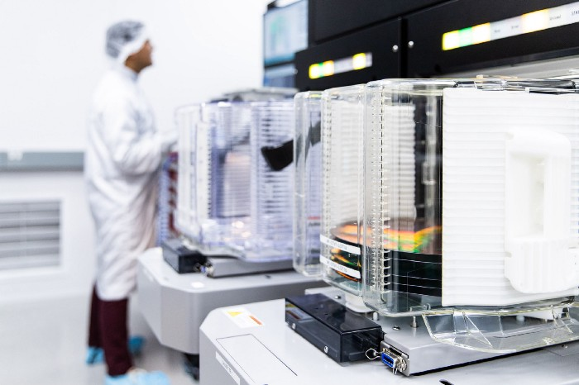
Welcoming PsiQuantum to the M12 portfolio - By Samir Kumar
https://medium.com/m12vc/welcoming-psiquantum-to-the-m12-portfolio-56926b455a8f
I’m excited to welcome PsiQuantum — a company building a scalable, fault tolerant, silicon photonic quantum computer — to the M12 portfolio.
The renowned physicist Richard Feynman said, “Nature isn’t classical…and if you want to make a simulation of nature, you’d better make it quantum mechanical, and by golly it’s a wonderful problem, because it doesn’t look so easy.” Feynman’s statement highlights two key ideas, both of which emphasize why we are excited to invest in PsiQuantum: truly emulating nature to foster new discoveries and breakthroughs requires a quantum approach. Secondarily, building a quantum computer is really hard.
A stack of PsiQuantum silicon wafers
being prepared for testing

Slide 5
Welcoming PsiQuantum to the M12 portfolio
Quantum computing promises to be a world-changing technology, but it’s important to look beyond the hype to understand why. The laws of quantum mechanics — the laws that govern the behavior and interactions of subatomic particles like electrons — form the foundation of quantum information science. This field has given rise to new classes of algorithms to solve many computationally hard problems, and — in some cases — previously intractable problems. Feynman’s intuition and key insight was that a computer operating by the rules of quantum information science could most accurately predict the behavior and characteristics of natural systems at their most fundamental level.
While we have seen incredible advances in computational chemistry and materials science enabled by increasingly powerful classical computers, key modelling capabilities remain intractable, or require simplifying assumptions and approximations that don’t scale. This is especially true for some of the most commercially relevant challenges. For example, we still don’t fully understand the mechanisms that would prompt a material to become superconducting at high temperatures. And in chemistry, our ability to accurately simulate the system dynamics and evolution of molecules with more than just a few atoms is significantly limited. A quantum computer has the potential to unlock commercial value in scenarios where current compute power is the constraint. Such a machine would also foster a new wave of developments in quantum algorithms in chemistry, materials, and other domains.

Slide 6
Welcoming PsiQuantum to the M12 portfolio
Feynman’s statement also eludes to the monumental technical challenge of building a useful quantum computer. But this is PsiQuantum’s goal. Their aim is to achieve it with a photonics-based substrate and a quantum computing architecture that is well suited to the advantages of photonics. It’s worth noting that PsiQuantum’s approach is different from Microsoft’s efforts in topological qubits (Microsoft’s approach would enable error correction in hardware via topological protection from local noise). PsiQuantum and Microsoft have different sets of engineering challenges to address with their distinct approaches, but the companies share the vision for a scalable, fault tolerant quantum computer.
PsiQuantum’s founders are renowned leaders in linear optical quantum computing. After spending 10+ years advancing the field in academia, they launched the company in 2015. Since then, they have attracted experts in silicon photonics, quantum architecture and semiconductor engineering to the team, including some of the most talented and distinguished researchers in fault tolerance and error correction. Needless to say, the team has deep roots in the quantum community.

Slide 7
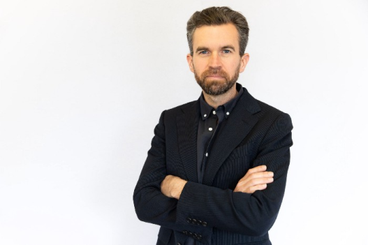
Welcoming PsiQuantum to the M12 portfolio
PsiQuantum CEO Jeremy O’Brien
Under the leadership of a sought-after founding team — Jeremy O’Brien (CEO), Terry Rudolph, Pete Shadbolt (CSO), and Mark Thompson (CTO) — PsiQuantum is focused on building photonic qubits with well-established semiconductor techniques and material substrates. They’re working with the world’s top commercial foundries — a testament to the company’s engineering-oriented efforts, instead of a reliance on the creation of fundamental scientific breakthroughs to make progress.
While it’s enticing to imagine the benefits and opportunities of a quantum computer, PsiQuantum isn’t distracted by what’s beyond the finish line. They are disciplined and focused on the task at hand: delivering on a machine with hundreds of error-corrected, logical qubits. We at M12 have been impressed by the PsiQuantum team and look forward to their continued development.
To learn more about M12, visit www.m12.vc.

Slide 8
END

